Slide 1
IBM | Coursera Data Analytics Capstone Project
Analysing Top Ten Businesses in Alimosho Local Government Area.
Prosper Popoola

Slide 2
01
Please enter your title
CONTENTS
02
Please enter your title
03
Please enter your title
04
Please enter your title

Slide 3
01
INTRODUCTION
Lagos is a big city with big potentials and opportunities, but most of these opportunities are not fully tapped, and this may be largely due to lack of data to inform profitable business decisions, and data based decision making on which type of business is good for a certain area in Lagos, but not good for other areas. Some business decisions have been made based on sentiments and/or not so well thought out advises.

Slide 4
02
PROBLEM DESCRIPTION
The data will show and rank the existing businesses in our choice area, using independent data from Foursquare. We will rank the top ten businesses in the choice area and probably for as far as ranking the least ten businesses.

Slide 5
03
WHO MAY BE INTERESTED IN THIS PROJECT?
Any business conscious person should be interested in the output of this project. Most especially business persons already operating or intending to open a business in our choice area. The output of the project could help in making informed decisions about the need for expansion or change of business type for profitability.

Slide 6
04
RESULT
We were able to classify the businesses in Akowonjo neighborhood, and the result as sampled below were shared into 5 clusters.

Slide 7
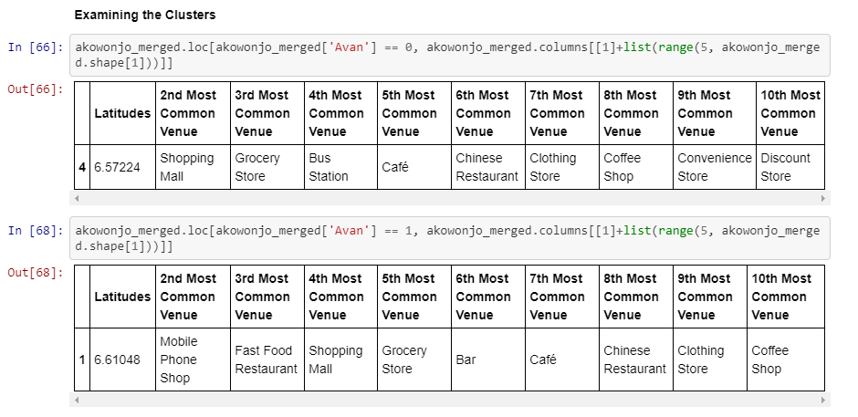

Slide 8
THANKS

